Slide 1
Movie Rating Prediction with Python
A Data Science Approach to Predicting Movie Ratings
Created by Ajay Khanna
Data Science Intern at Afame Technologies

Slide 2
Table of Contents
Project Overview
Business Understanding
Objectives
Data Understanding
Exploratory Data Analysis (EDA)
Modeling
Recommendations
Conclusion
Next Steps

Slide 3
Project Overview
Project Description
The Movie Rating Prediction project involves analyzing a dataset containing information about Indian movies. The dataset includes details like movie name, year, duration, genre, rating, votes, director, and three main actors. The data will be used to build a predictive model for movie ratings and extract valuable insights from the movie industry.
Business Understanding
The film industry relies on understanding the factors that influence movie success. Accurately predicting movie ratings can aid in decision-making, such as choosing the right actors, directors, and genres, as well as determining marketing strategies

Slide 4
Objectives
Develop a predictive model: Create a machine learning model to predict movie ratings based on the provided dataset. This is essentially a regression problem, where we aim to estimate the numerical movie ratings based on various features.
Identify influential factors: Analyze the dataset to determine which factors (e.g., genre, director, actors) have the most significant impact on movie ratings.
Provide actionable insights: Offer insights to the film industry stakeholders to make informed decisions about movie production, casting, and marketing.

Slide 5
Data Understanding
Dataset Source:
Kaggle (IMDb India Movies)
Key Features:
- Name, Year, Duration, Genre
- Rating (Target), Votes, Director
- Actor 1, Actor 2, Actor 3
Target Variable: Rating

Slide 6
Tools and Technologies USED
Programming Language
- Python: The core language for the analysis and modeling.
Libraries for Data Analysis and Preprocessing
- Pandas: For data manipulation and cleaning.
- NumPy: For numerical computations.
- Matplotlib/Seaborn: For data visualization.
Machine Learning and Model Building
- Scikit-learn: For preprocessing, model training, and evaluation.
- XGBoost or LightGBM: For gradient boosting techniques.
Others
- Jupyter Notebook: Environment for writing code and documenting the project.
- SciPy/Statsmodels: For statistical analysis.

Slide 7
Exploratory Data Analysis (EDA)

Slide 8
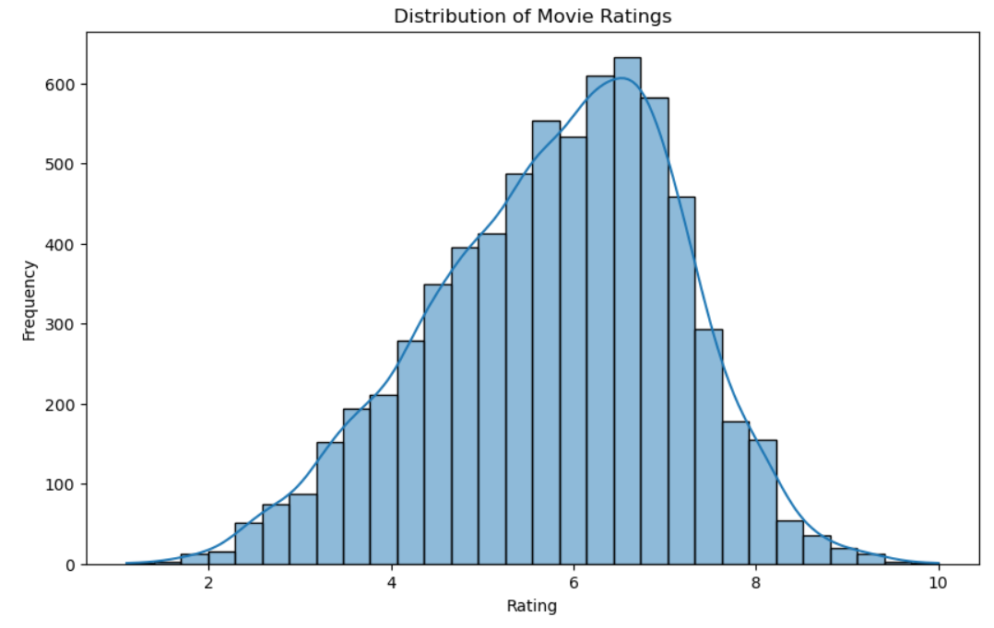
Rating Analysis
Rating Distribution: The histogram shows a slightly normal distribution with a peak around a 7 rating value.
Common Rating Range falls between 5 to 7.
All ratings are positive
There are few movies rated below 2 and above 8

Slide 9
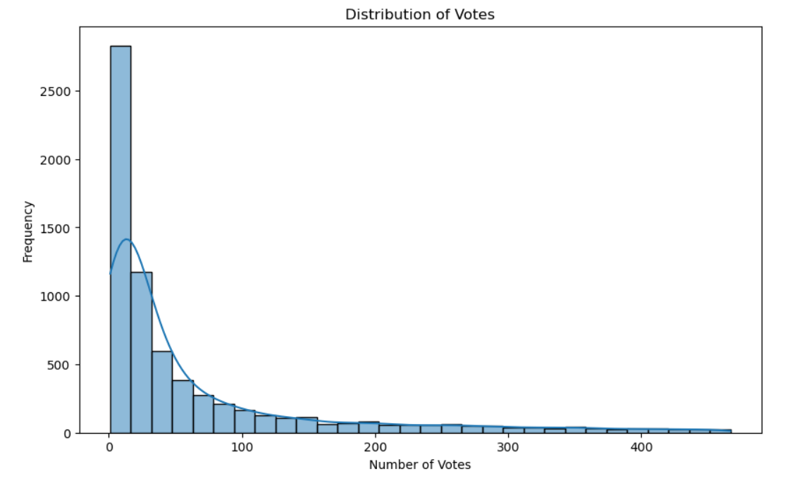
Votes Analysis
The distribution of votes is right-skewed, with the majority of movies receiving a relatively low number of votes. This suggests that many movies in the dataset may not be widely recognized or popular, as they have received fewer votes
The long tail towards higher vote counts indicates that there are a smaller number of movies that have garnered a significant number of votes
Popularity Range is between 0 and 50

Slide 10
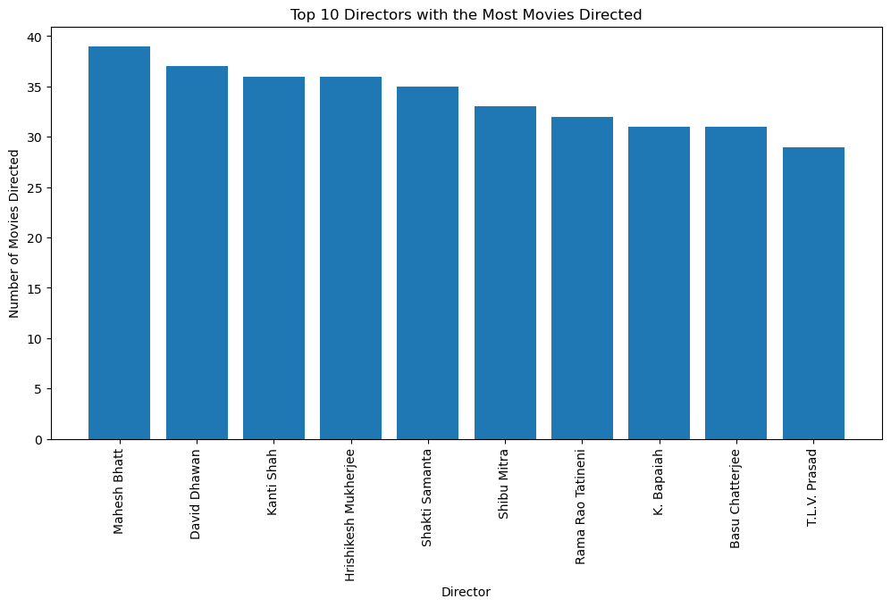
Top 10 Directors with the Most Movies Directed
Mahesh Bhatt directed the most movies
The above directors are quite prolific in their careers.

Slide 11
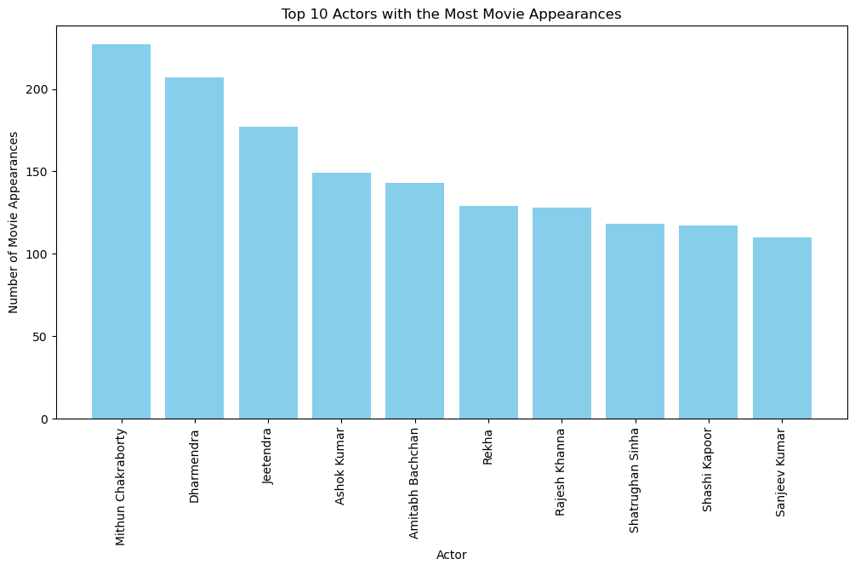
Top 10 Actors with the Most Movie Appearances
Prolific Actors: The top 10 actors have made a substantial number of movie appearances, indicating their prolific careers in the film industry
The actor who appeared the most in these movies is Mithun Chakraborty.

Slide 12
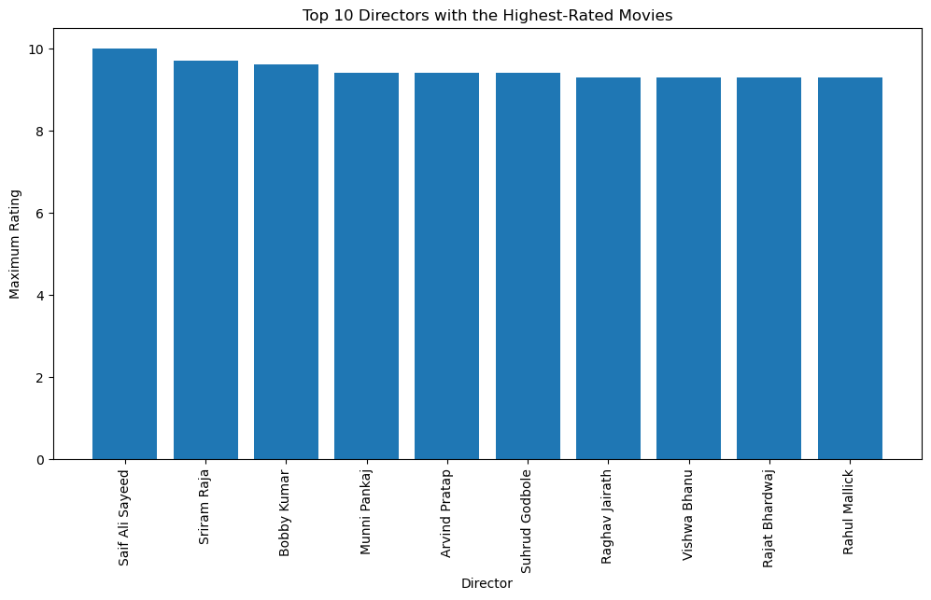
Top 10 Directors with the Highest-Rated Movies
Saif Ali Sayeed has directed the most succcessful Movies among other directors. This shows that the likelyhood of a movie to be rated high if directed by him is high.

Slide 13
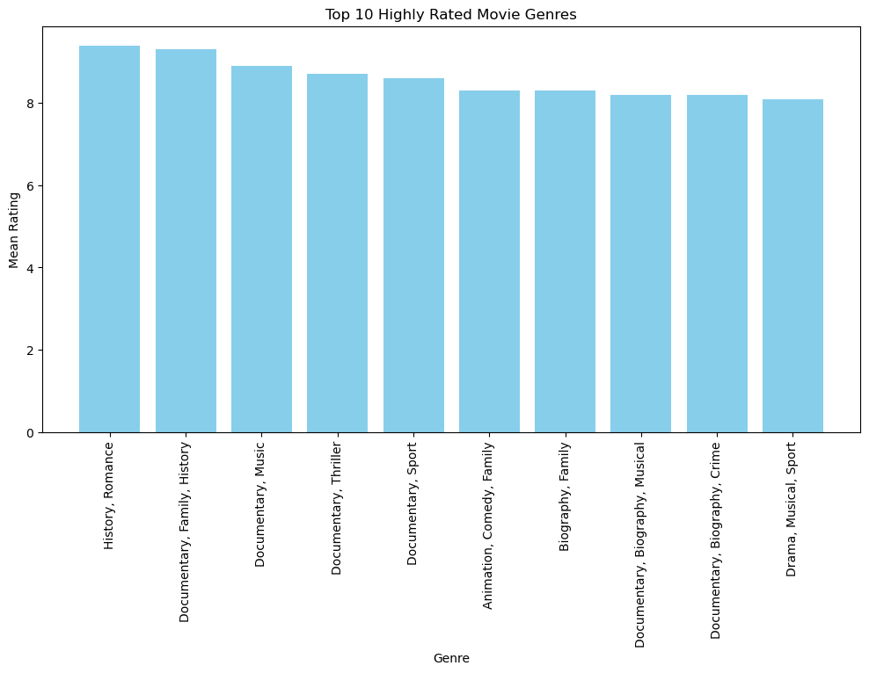
Top 10 Highly Rated Movie Genres
Genre Popularity: The top 10 highly rated genres are likely to be popular among audiences, as reflected in their mean ratings
History, Romance genre has the highes rating hence wise to investing in the genre
Critical Acclaim: High mean ratings often indicate that these genres receive positive reviews and critical acclaim from both audiences and critics.
Filmmakers, actors, and production companies may consider collaborating within these genres to create well-received movies.

Slide 14
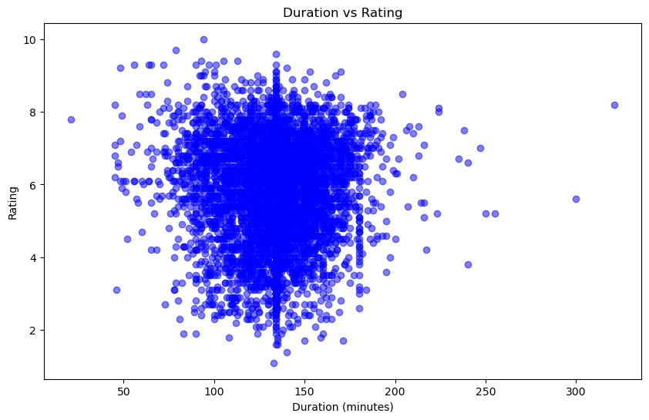
Duration vs Rating
There doesn't appear to be a strong linear relationship between movie duration and ratings. you can't easily predict a movie's rating based solely on its duration.

Slide 15
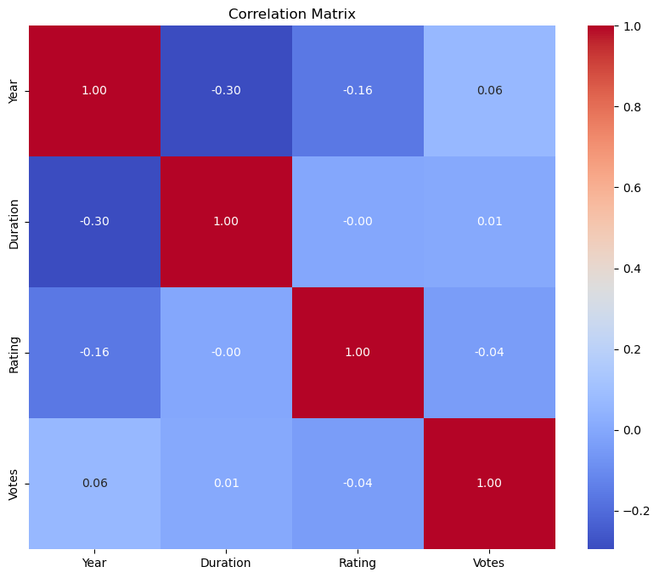
Correlation Matrix
The variables are not Highly correlated. The absence of strong correlations between numerical variables is a positive sign, as it reduces the risk of multicollinearity in regression analysis

Slide 16
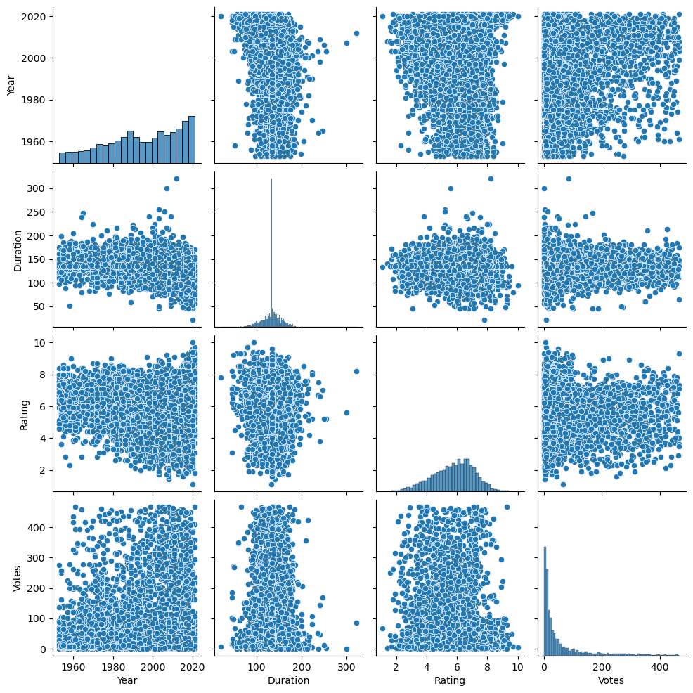
Pairplot
No strong correlation between variables

Slide 17
Modeling
Baseline Model - Linear Regression
Second Model - Random Forest Model
Third Model - Gradient Boosting Regressor
Hyperparameter Tuning of Random Forest Model
The tuned Random Forest performed better than the tuned model in terms of model generalization and avoiding overfitting, due to its more balanced performance between training and test data. This will be the final model used for prediction.

Slide 18
Model Evaluation
Metrics:
- Mean Squared Error (MSE)
- R-squared (R²)
Visualization of predicted vs actual ratings.

Slide 19
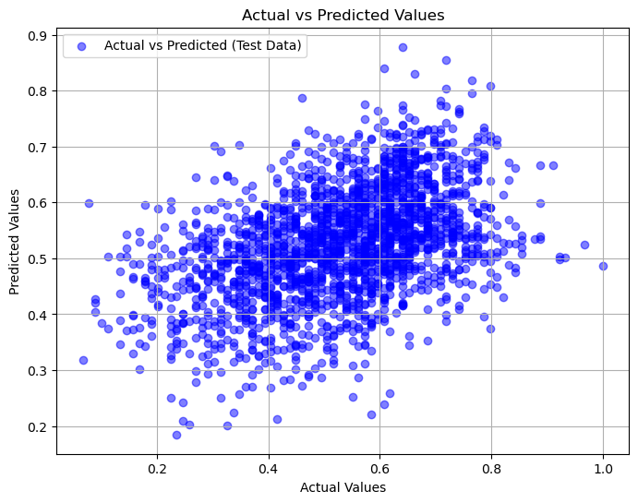
The scatter plot likely shows a scattered pattern of points away from the diagonal line, which aligns with the negative Test R^2 and non-ideal Test MSE. These results collectively suggest that the Linear Regression model is not a good fit for predicting movie ratings and may require improvement, such as exploring more complex models or refining feature selection and engineering.

Slide 20
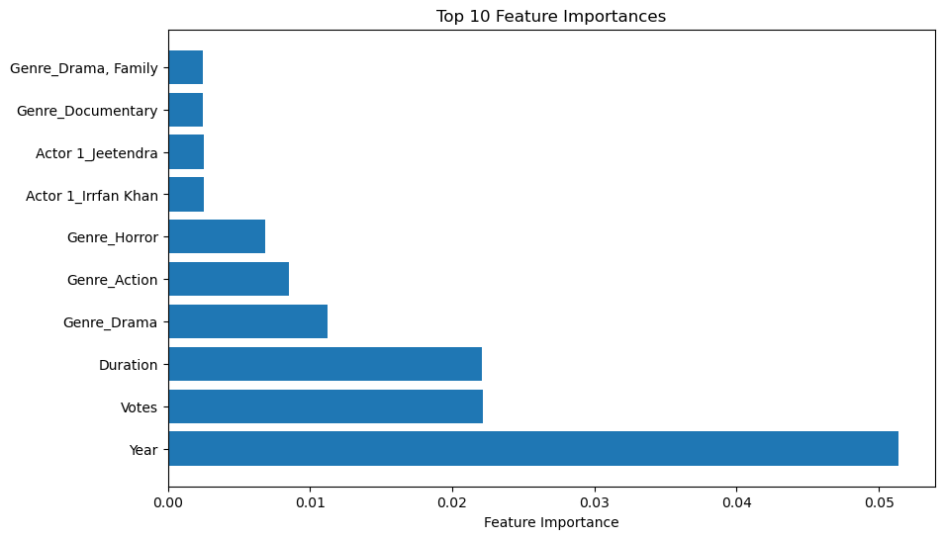
Most Important Features
Features that had most significant impact on the target variable in the above model:
Year
Votes
Duration

Slide 21
Recommendations
Year: Stay current with trends for successful movie releases.
Votes: Encourage audience reviews for more reliable ratings.
Duration: Align with audience preferences for movie length.
Collaboration: Partner with established industry figures.
Genres: Invest in highly-rated genres like History and Romance.
Duration vs. Ratings: No strong duration-rating correlation.
Critical Acclaim: Aim for positive reviews and acclaim

Slide 22
Conclusion
In conclusion, this project provides valuable insights and a predictive model for movie rating prediction. The film industry can benefit from these findings to make data-driven decisions regarding movie production, casting, and marketing. The most influential factors identified are the year of release, the number of votes, and movie duration.

Slide 23
Next Steps
Model Refinement: Improve the rating prediction model with advanced machine learning methods.
Feature Engineering: Enhance the model's performance by experimenting with new features.
User Reviews Analysis: Analyze user reviews and sentiments for deeper audience insights.
Real-time Data: Implement real-time data updates to keep the model current with the latest trends

Slide 24
Appendix
For notebooks, datasets and scripts, follow this GitHub Repository link:
https://github.com/Ajay15Khanna/Afame-Technologies-Data-Science-Intern

